Slide 1

Syracuse Abroad &
Center for Fellowship and Scholarship Advising

Slide 2
What is the Gilman Scholarship Program?
Study Abroad scholarships for U.S. students with high financial need
Supports students regardless of major or career goals
Established by U.S. Congress and funded by the U.S. State Department – this is an “external scholarship”.

Slide 3
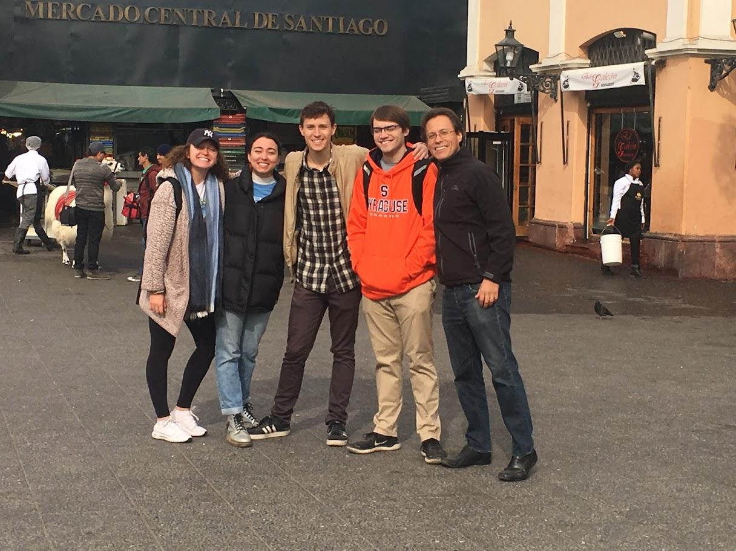
How much funding might I receive?
Award Amounts:
Up to $5,000 for a semester or summer program
Up to an additional $3,000 for study of a “critical need language”
Up to an additional $1,000 to support STEM research while abroad

Slide 4
Am I eligible to apply?
U.S. Citizens
Pell Grant Recipients
Undergraduate students in good standing
No GPA requirement, but GPA is considered as part of determining academic preparation for study abroad.

Slide 5
Eligible Study Abroad Programs
No minimum length. Cannot be longer than one academic year
For October deadline, program must start between Dec 1, 2026 and Oct 31, 2027 (i.e. Winter 2027, Maymester 2027, summer 2027, Fall 2027, and academic year 2027-28 programs)
Multi-destination programs are eligible
Intended study abroad program is in a country with Level 1 or 2 on U.S. State Department’s Travel Advisory System
Must be credit-bearing
Program that connects well with your future academic and career goals

Slide 6

How do I apply for Gilman?
Start your application on the Gilman Scholarship Website
Know your program details (dates, cost, estimated SU financial aid package)
Copy of unofficial transcript
Four essay questions
Additional essays for critical language applicants and STEM award
NO letters of recommendation

Slide 7
Gilman Selection Criteria
Impact of the study abroad program and location on student’s academic and career trajectory
Preparedness for abroad program
Ability to represent the U.S. abroad, and hometown impact
Critical Need Language Award: Commitment to proficiency in a critical need language
STEM supplement: Commitment to a STEM field

Slide 8
How might receiving the Gilman Scholarship affect my financial aid?
Gilman applications must be certified by the Office of Financial Aid
Adjustments might be made to your aid package only if your total funds exceed your need-level or total cost of attendance.

Slide 9

Application Essays

Slide 10
STATEMENT OF PURPOSE
ESSAY 1: MOTIVATIONS FOR STUDYING OR INTERNING ABROAD
Prompt: (500 word max)
  Make the case for why your study abroad academic/ internship experience would contribute to your future academic and/or career goals.
  Why did you select your specific program or internship and host country?

Slide 11
STATEMENT OF PURPOSE
ESSAY 2: KNOWLEDGE AND SKILL DEVELOPMENT THROUGH STUDYING AND INTERNING ABROAD
Prompt: (500 word max)
  Please describe specific examples in which your skills and/or experiences (academic, professional, extracurricular and/or volunteer activities, etc.) have equipped you to effectively adapt to and succeed in your host country.
  What specific knowledge and skills do you hope to develop through your experience abroad?

Slide 12
REPRESENTING AMERICA ABROAD AND HOMETOWN IMPACT
ESSAY 3: GILMAN SCHOLARS AS CITIZEN DIPLOMATS
Prompt:
Describe your plans and strategies for engaging your host community and showcasing what it means to be an American.

Slide 13
REPRESENTING AMERICA ABROAD AND HOMETOWN IMPACT
ESSAY 4: CONTRIBUTIONS TO U.S. COMMUNITIES AND FOLLOW-ON SERVICE PROJECT PROPOSAL
Prompts: (500 word max)
Describe your Follow-on Service Project, including how it will highlight the critical role of study abroad in enhancing career readiness and strengthening U.S. global leadership.
How will you showcase support available through the Gilman Program?
Who is the primary audience for your follow-on service project and why have you selected them?

Slide 14
SUPPLEMENTAL ESSAYS (300 words)
Critical Need Language Award
What are your motivations for learning and/or improving proficiency in your targeted language for your academic and/or career success?
Describe your plan to develop your language skills while studying abroad, both inside and outside of the classroom setting.
STEM Supplemental Award
Summarize your STEM-related coursework/research plans overseas and how it contributes to your future academic and/or career goals.

Slide 15
ESSAY TIPS 1
Answer all prompts
Follow all formatting requirements:
  One page single-spaced, with 1-inch margins, and using Times New Roman 12-point font. Do not exceed the 500-word limit for each essay.
Demonstrate strong writing skills: compose coherent paragraphs with a clear topic sentence followed by evidence supporting that topic.
Proofread
Your essay should be close to (and not over) the 500-word limit, including spaces

Slide 16
ESSAY TIPS 2
It’s all about the details! Make sure your reader leaves your essays knowing your:
  Major
  Career goals – be reasonably specific
  Academic and interpersonal preparation for study abroad
  Hometown
  Specific plans for study abroad: destination, duration, living situation, relevant classes and/or internships
  Specific, feasible plans for follow-on service project: target audience, timing, resources
Do not use AI to generate your content! But you may choose to use it to help you proofread your essay and organize your own ideas.

Slide 17

Hear from a Gilman Recipient!
Mikah Bein
Fall 2024 Gilman Scholarship Recipient
Studied abroad in Copenhagen, Denmark

Slide 18
Gilman Application Timeline
EVENTS | DATES
Writing Workshop #1 | Thursday, September 10|11:00am-1:00pm| 6th floor 100 Sims Drive
Writing Workshop #2 | Thursday, September 24|10:00am-12:00 pm|6th floor 100 Sims Drive
Writing Workshop #3 | Friday, September 25| 2:00-4:00pm |6th floor 100 Sims Drive
Writing Workshop #4 | Monday, September 28| 10:00am-12:00pm|6th floor 100 Sims Drive
Gilman Application Deadline | Thursday, October 1 | Online Submission
Sign up here: LINK

Slide 19
SU Abroad Application Timelines
All Spring 2027 semester abroad applications have closed
Spring 2027 Short-Term programs: September 10, 2026 – October 15, 2026
Summer 2027 programs: September 10, 2026 – February 1, 2027
Fall 2027 Center semester programs: November 15, 2026 (9:00 a.m. EST) – March 15, 2027
Fall 2027 World Partner semester programs: November 15, 2026 (9:00 a.m. EST) – February 1, 2027
NOTE: Some programs may have deadlines earlier than the ones above. For all program deadlines and to stay up-to-date regarding the Syracuse Abroad application process, please refer to https://suabroad.syr.edu/apply

Slide 20

What is the certification process?
Advisors must certify the relevant study abroad & financial aid related information
Study Abroad Advisor
Financial Aid Advisor
Please do not email your advisors to inform us of your submitted application. Rest assured, we will certify your application within 1 week of the deadline!

Slide 21
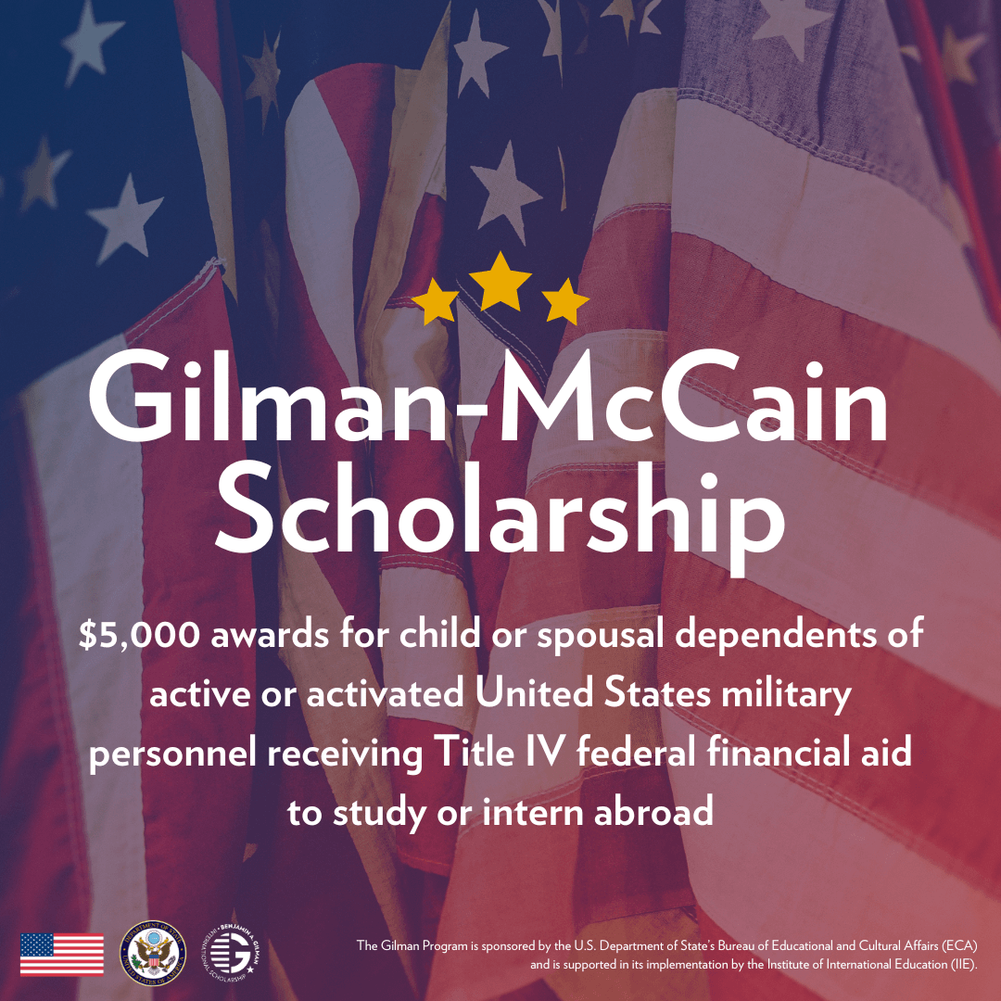
The Gilman-McCain Scholarship
Am I eligible for the Gilman-McCain?
  Almost the same as Gilman but:
  Dependent child of an active-duty military member(s) during the time of application in one of the following branches:
    Air Force, Air Force Reserve, Air National Guard, Army, Army National Guard, Army Reserve, Coast Guard, Coast Guard Reserve, Marine Corps, Marine Corps Reserve, Navy, Navy Reserve, Space Force, NOAA Commissioned Corps, and USPHS Commissioned Corps
  Recipient of any type of Title IV federal financial aid (Pell, SEOG, etc.)
  Must provide valid military identity documentation in application

Slide 22

Where to Go for Application Support
Study Abroad Questions:
Syracuse Abroad Website
Meet with an International Program Advisor
Chat with a Global Ambassador
Scholarship Essay Assistance:
Center for Fellowship & Scholarship Advising – book an appointment
Financial Aid Concerns:
Your Financial Aid advisor – book an appointment

Slide 23

Our advice?
Sign up to attend CFSA’s writing workshops.
Start drafting your essays as soon as possible.
Visit the Gilman website for essay tips, examples of follow-on projects, and more! https://www.gilmanscholarship.org/

Slide 24

Questions?
www.gilmanscholarship.org/

